Slide 1
CHAPTER-4
FOUR STROKE
&
TWO STROKE CYCLE ENGINE

Slide 2
The I. C. engines classified on the basis of strokes per cycle are two stroke and four stroke cycle engine. The construction and working principle of these engines along with the points of differentiation are discussed in this chapter.
Working of four stroke cycle engine
In four stroke cycle engines there are four strokes completing two revolutions of crank shaft and one revolution of cam shaft.
The four strokes are:
  Suction stroke
  Compression stroke
  Power stroke and
  Exhaust stroke.

Slide 3
SUCTION STROKE:
Piston moves from TDC to BDC.
Intake/suction valve gets opened whereas exhaust vale remains closed.
During this stroke the pressure inside the combustion chamber drops below the atmospheric pressure hence outside air enters in the combustion chamber.
In case of CI engine, only air is taken inside the combustion chamber through intake/suction valve.
In case of SI engine, mixture of air and fuel (charge) is taken inside the combustion chamber.

Slide 4
B) COMPRESSION STROKE:
Piston moves from BDC to TDC.
Both valves (suction & exhaust) remains closed during this stroke.
In case of CI engine
Air is compressed (due to upward movement of the piston) in the clearance volume and air becomes super heated at the end of this stroke.
The compression ratio for diesel engine usually varies from 14:1 to 22:1
The temperature at the end of compression stroke reaches to 650ºC to 800ºC
The pressure at the end of compression stroke reaches to 30 to 45 kg/cm²
At the end of this stroke Diesel fuel is sprayed at a pressure of 140 – 160 Kg/cm² into the combustion chamber.
Due to High Pressure Super Heated (HPSH) air inside the combustion chamber the fuel ignites and tremendous amount heat is generated causing high pressure in the combustion chamber, which pushes the piston backwards (towards BDC) for useful work.

Slide 5
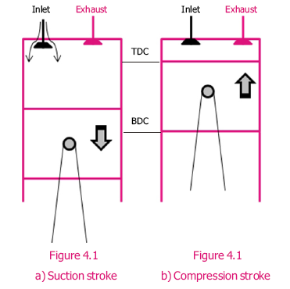

Slide 6
In case of SI engine
Mixture of air and fuel (charge) is compressed (due to upward movement of the piston) in the clearance volume.
The air-fuel mixture varies from 10:1 to 20:1
The compression ratio for petrol engine varies from 4:1 to 8:1
The spark is produced at the end of this stroke and fuel gets ignited and tremendous amount of heat is generated causing high pressure in the combustion chamber which pushes the piston backwards (towards BDC) for useful work.

Slide 7
POWER STROKE:
During the power stroke, the high pressure developed due to combustion of fuel causes the piston to be forced in downward direction (towards BDC).
Piston moves from TDC to BDC.
Both valves (intake/suction and exhaust) remains closed during this stroke.
The temperature after the ignition of diesel reaches to
1650 ºC to 1925ºC.
The pressure falls from maximum value (45 kg/cm²) to 3.5 to 5 kg/cm²
The connecting rod transmits the power to the transmission system with the help of crank shaft.

Slide 8
EXHAUST STROKE:
Piston moves from BDC to TDC.
Inlet valve remains closed and exhaust valve opens.
Pressure of exhaust gases inside the combustion chamber is more than atmospheric pressure hence, exhaust gases go out through exhaust valve during this stroke.
The temperature of exhaust gases remains around 650 ºC
All the burnt gases go out of the cylinder and become ready to receive the fresh air or air-fuel mixture.
Thus out of four strokes only one stroke is a power stroke or working stroke and remaining three strokes are idle strokes.

Slide 9
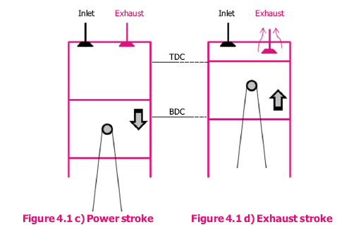

Slide 11
Working of
Two stroke cycle engine

Slide 12
Working of two stroke cycle engine
In two stroke cycle engines all the strokes viz. suction, compression, power and exhaust are completed in two strokes of piston and
one complete revolution of crank shaft.
Two stroke cycle engines have no valves. Suction of air or air-fuel mixture and exhaust of burnt gases takes place through the holes called ports in the cylinder.
There are three ports viz.
1. suction/inlet port,
2. exhaust port and
3. transfer port.
The exhaust port and transfer port are opposite to each other and the suction port is below the exhaust port (Fig. 4.2)

Slide 13
As the two stroke diesel engines are now not in use
therefore,
only two stroke petrol engine is described.

Slide 14
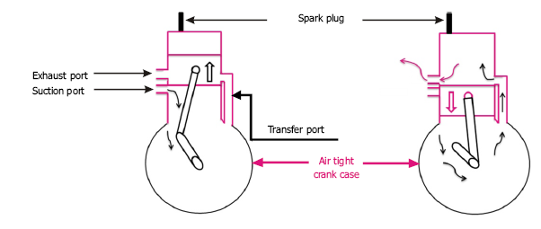
Fig. Working of two stroke cycle engine

Slide 15

FIRST STROKE (SUCTION + COMPRESSION) Figure 4.2 a.
During this stroke the piston moves up in the cylinder, and it covers exhaust port and transfer port. This traps the air-fuel mixture in the cylinder.
Further upward movement of the piston compresses this air-fuel mixture.
The compression ratio for petrol engine varies from 5:1 to 8:1
E
S
T
Further upward movement of the piston uncovers a third (suction) port and fresh charge is drawn in the airtight crankcase through carburetor.
Just before the end of this stroke, spark plug produces the spark and fuel is ignited in the cylinder.
S

Slide 16
B) SECOND STROKE (POWER + EXHAUST)
Ignition of charge causes the rise in the pressure in the cylinder which forces the piston downward.
When the piston goes down, it covers and closes the suction port, trapping the air-fuel mixture drawn into the crankcase in previous stroke and slightly compresses it.
Further downward motion of the piston uncovers first exhaust port and then transfer port. The burnt gases having more pressure than atmospheric pressure flow out through the exhaust port. Also pre-compressed fresh air-fuel mixture is transferred into the cylinder through the transfer port.
T
ES
T
In two stroke cycle engine some type of blower or compressor is used to remove exhaust gases from the engine cylinder because entire burnt gases do not go out in normal stroke.
The process of removal of burnt gases (exhaust gases) from the engine cylinder is known as scavenging.

Slide 17
Difference between two stroke and four stroke engine
Sr. No. | Four Stroke Engine | Two Stroke Engine
1. | One power stroke for every two revolution of the crankshaft. | One power stroke for each revolution of the crankshaft.
2. | There are inlet and exhaust valves in the engine. | There are inlet, exhaust and transfer ports instead of valves.
3. | Crankcase is not fully closed and air tight. | Crankcase is fully closed and air tight.
4. | Top of the piston compress the charge. | Both sides of piston compress the charge.
5. | Size of the flywheel is comparatively larger. | Size of the flywheel is comparatively smaller.
6. | Fuel is fully consumed. | Fuel is not fully consumed.
7. | Weight of engine per hp is high. | Weight of engine per hp is comparatively low.
8. | Thermal efficiency is high. | Thermal efficiency is comparatively low.
9. | Removal of exhaust gases is easy. | Removal of exhaust gases is comparatively difficult.
10. | For lubrication separate lubrication system is provided. | For lubrication oil is generally mixed with the fuel.
11. | All types of speed are possible. | Mostly high speed engines are there.
12. | It can be operated in one direction only. | It can be operated in both directions.

Slide 18
Difference between diesel engine and petrol engine
Sr. No. | Diesel Engine | Petrol Engine
1. | It has got no carburetor, ignition coil and spark plug | It has got carburetor, ignition coil and spark plug.
2. | It’s compression ratio varies from 14:1 to 22:1. | It’s compression ratio varies from 5:1 to 8:1.
3. | It uses diesel oil as fuel. | It uses petrol or power kerosene.
4. | Only air is sucked in cylinder in suction stroke. | Mixture of air and fuel sucked in cylinder in suction stroke.
5. | It has got fuel injection pump. | It has got no fuel injection pump.
6. | Fuel is injected in combustion chamber and ignited due to heat of compression. | Air fuel mixture is compressed in the combustion chamber where ignited by an electric spark.
7. | Thermal efficiency is 32 to 38 %. | Thermal efficiency is 25 to 32 %.
8. | Engine weight per hp is high | Engine weight per hp is low.
9. | Operating cost is low | Operating cost is high.
10. | Compression pressure inside the cylinder varies from 35 to 45 kg/cm² and temperature is about 500^{O}C. | Compression pressure varies from 6 to 10 kg/cm² and temperature is about 260^{O}C.

Slide 19
Problems
1. Sol^{n} | Calculate the BHP of a 4 stroke, 4 cylinder I.C. engine which has cylinder bore = 12.5 cm, stroke length = 15 cm., Crank shaft Speed = 1000 rpm, frictional HP = 30, mean effective pressure = 7 kg/cm² IHP = (PLAN /4500) * (n/2) = (7 * 0.15*(П/4)*(12.5)² * 1000 /4500) * (4/2) = 57.26 BHP = IHP-FHP = 57.26 – 30 = 27.26

Slide 20
2. Sol^{n} | A four cylinder four stroke gas engine has cylinder diameter of 25 cm, stroke bore ratio is 1.8, clearance volume 4500 cm³, engine speed 240 rev/min, mean effective pressure 6.8 kg/cm² and mechanical efficiency is 75 per cent, calculate (1) IHP, (2) BHP, (3) Compression ratio, and (4) Swept volume. Stroke-bore ratio (L/D) = 1.8, so stroke, L = 1.8 * D = 1.8 x 25 cm = 45 cm = 0.45 m IHP = (PLAN /4500) * (n/2) = [6.8 x 0.45 x П/4 x 25² x 240 / 4500] x 4/2 = 160.22 BHP = IHP x mech. Eff. = 160.22 x 0.75 = 120 Swept volume = П/4 x D² x L = П/4 x 25² x 45 = 22089.32 cm² Compression ratio = (swept vol. + Clearance vol.)/ Clearance vol. = (22089.32 + 4500) / 4500 = 5.90

Slide 21
3. Sol^{n} | A four stroke engine has a mean effective pressure of 7 kg/cm², area of piston is 730 cm², stroke length 45 cm, torque due to break load is 110 kg-meter, fuel consumed per hr. is 4.5 kg and working speed 120 r.p.m. Find IHP, BHP, Mech. Efficiency and specific fuel consumption. IHP = (PLAN /4500) * (n/2) = [7.0 x 0.45 x 730 x 120 / 4500] x 1/2 = 30.8 BHP = 2ПNT/4500 = (2 x П x 120 x 110 ) / 4500 = 18.4 Mech. Efficiency, % = BHP/IHP x 100 = (18.4/30.8) x 100 = 59.7 % Specific fuel consumption = 4.5 kg per hr/18.4 hp = 0.245 kg per hp-hr.

Slide 24

Thank you

